Slide 1

AI's Evolutionary Path:
What the Future Holds
BY HYOJUN KIM

Slide 2
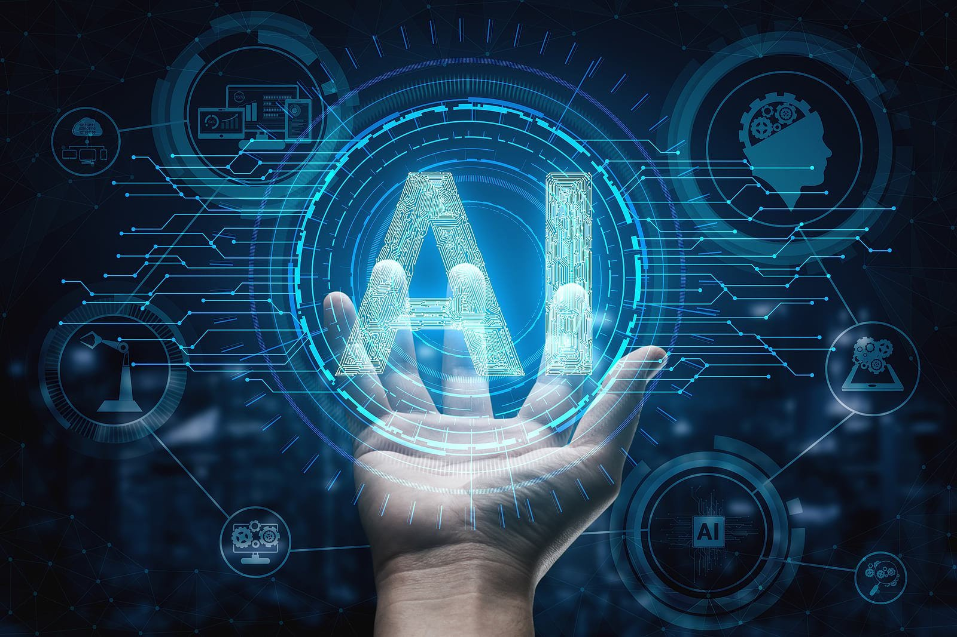
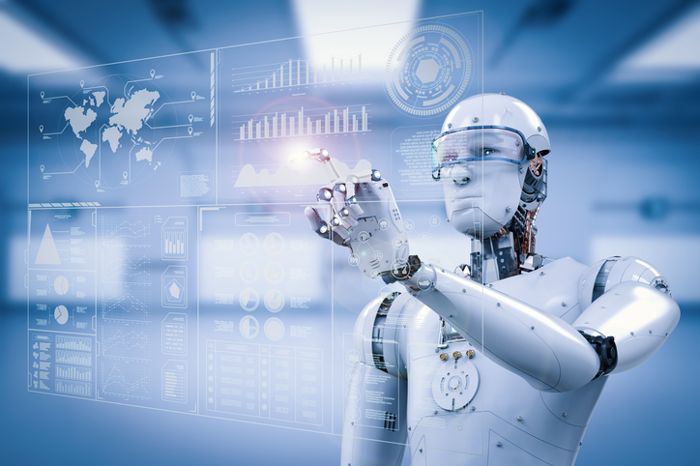
Executive Summary
Objective:
To elucidate the transformative impact of AI across various professions and industry sectors by analyzing news articles, and to provide actionable recommendations.
Approach & Methodology:
Utilized NLP techniques, such as data preprocessing, topic modeling, classification, customized targeted sentiment analysis, and Named Entity Recognition.
Key Insights:
Prominent Figures: Sam Altman, Joe Biden rank amongst the top-mentioned in AI discussions.
AI Impact on Jobs: Engineer, investor, and manager roles are prominently discussed.
Trending AI Technologies: Machine learning and ChatGPT dominate the AI tech conversation.
News Focus: Market analysis, AI business solutions, and technological advancements are key themes.
Sentiment Trend: AI sentiment on the rise; Sam Altman praised, ChatGPT with mixed reactions.
Embracing AI-driven transformations is pivotal for future-ready industries and professions.

Slide 3
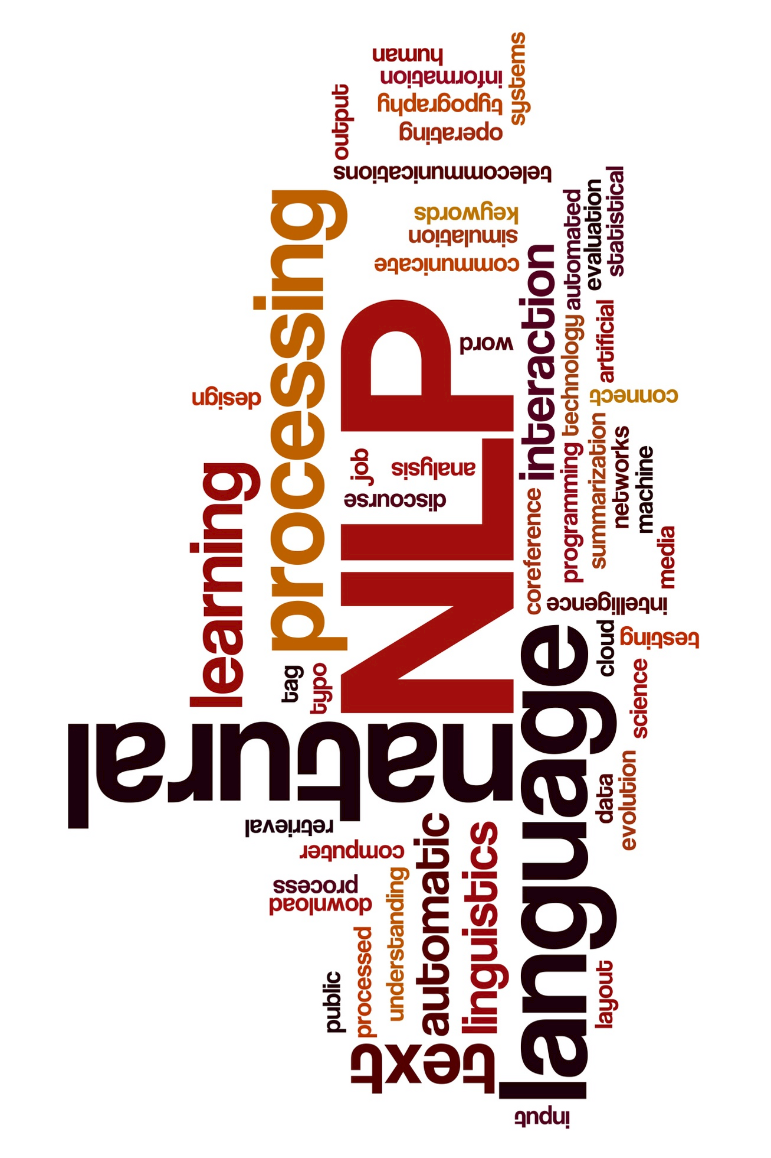
Agenda
Data Preprocessing
Explanation of steps taken to clean and prepare the data.
Exploratory Data Analysis
High-level overview of data characteristics and patterns.
LDA Topic Modeling
Dive into Latent Dirichlet Allocation and its findings.
Classification Model
Classify data by input features.
Run subsequent LDA on each classified topic.
Sentiment Analysis
Integrate VADER & Yelp models to improve sentiment analysis
Create blended approach for review sentiment categorization.
Blended Sentiment Over Time
NLP Techniques
Name Entity Recognition
Highlight entities & their significance.
Targeted Sentiment Analysis
Entities with sentiments linked to visuals highlighting discoveries.
NLP Insights
Leading Companies Investing in AI's Future
Top Impacted Jobs
Top New Tech. & AI Solutions
Applications Challenging for AI Adoption
Actionable Recommendations
Analysis insights to devise strategies and initiatives.
©2023 Proprietary and Confidential. All Rights Reserved.

Slide 4



Data Preprocessing
Article Clean-Up and Filtering
Text Extraction & Cleanup
Tokenization & N-Gram Creation
Stopword Removal
Dictionary & Corpus Formation
Normalization
Lemmatization
Discard irrelevant articles.
Extract only 'text' to reduce redundancy.
Convert text to lowercase.
Remove punctuation, urls, and diacritics.
Decompose text into individual words.
Create meaningful bigrams, trigrams from tokenized words.
Filter out common words like 'the', 'a', 'and' that don't add meaning.
Reduce words to their root form, e.g. 'running' to 'run'.
Create a dictionary from lemmatized words.
Transform the dataset into a corpus for modeling.

Slide 5
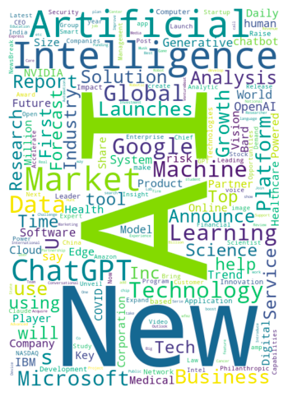
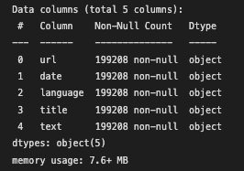
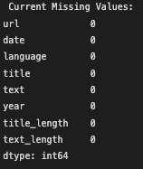
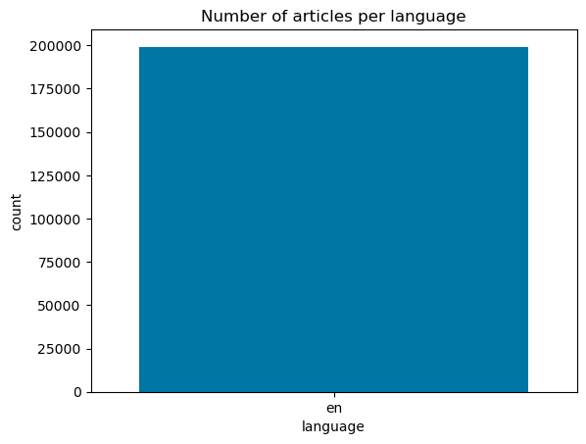
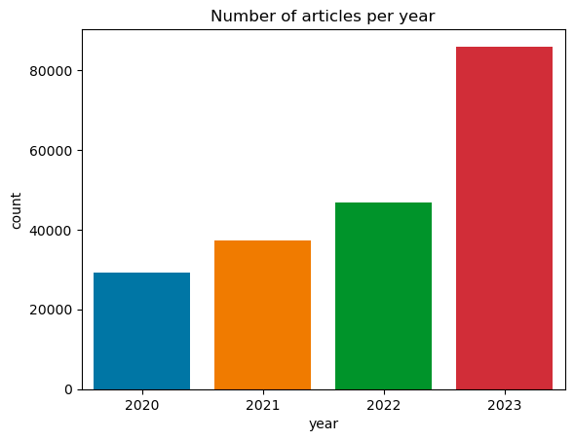
Exploratory Data Analysis
Unpacking the News Data: From Basic Information to Visual Insights

Slide 6
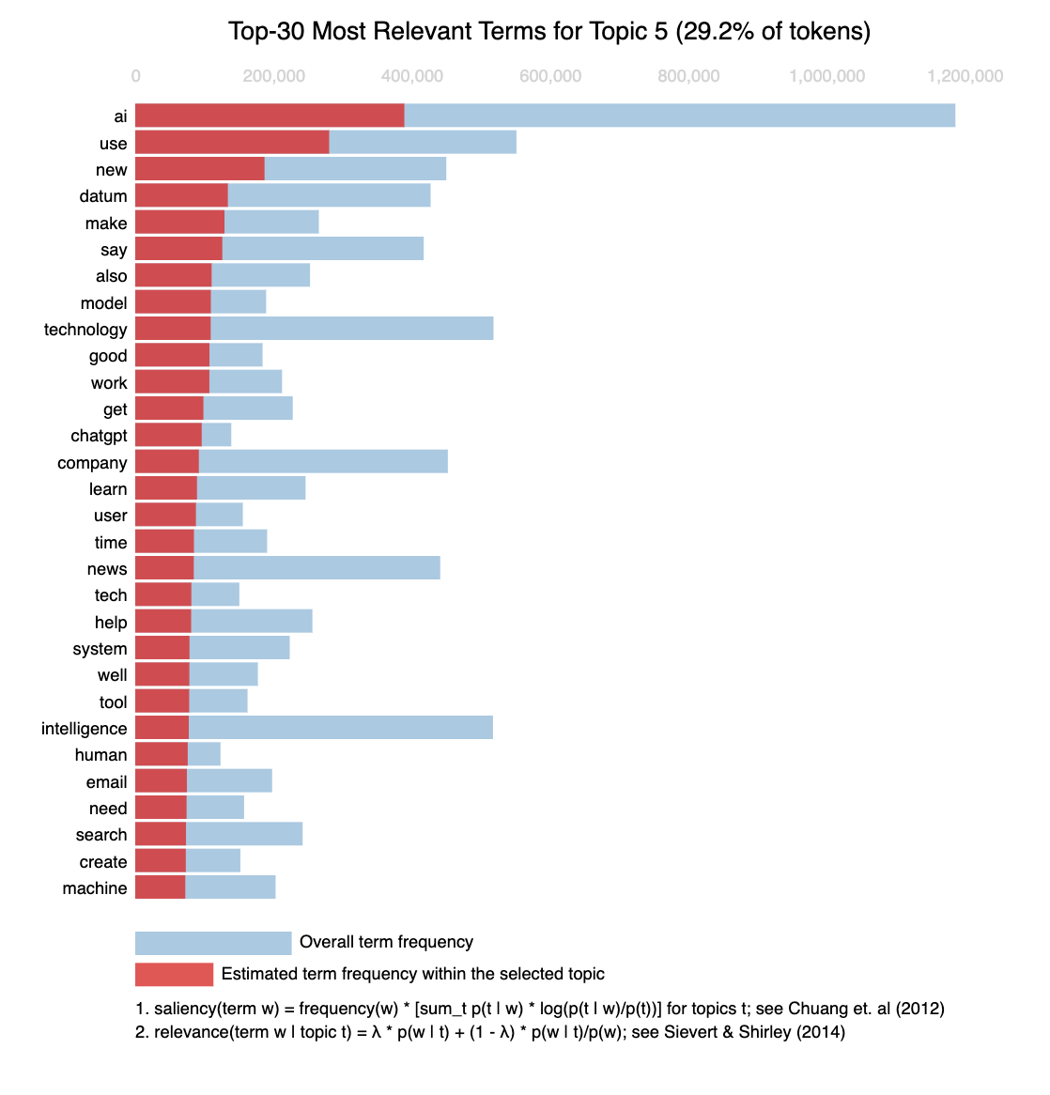
LDA Topic Modeling on News Articles
Objective
Identify topics in a news corpus using LDA and optimize model coherence.
Model Selection
LDA (Latent Dirichlet Allocation) chosen for its effectiveness in topic modeling.
Methodology
Hyperparameter Tuning: Evaluated various topic counts, alpha & beta configurations. Evaluation: Used Coherence Score for model optimization.
Optimal Model Parameters
Topics: 5 Alpha: Asymmetric Beta: Auto Top Coherence Score: 0.440046
Top Identified Topics
News Trends: 'say', 'news', 'ago', 'ai', 'video'... Market Reports: 'market', 'report', 'intelligence', 'artificial'... Tech & Business: 'ai', 'technology', 'datum', 'company'...
Github Link for Topics Visualization
Click: Download html and Select Topic Model

Slide 7
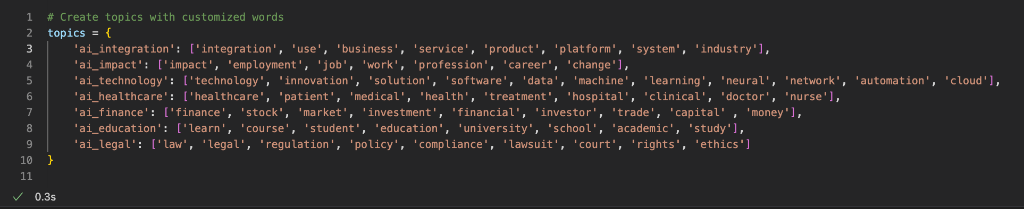
Classification Model & Subsequent LDA
Objective
Further categorize AI-related articles (from LDA) into predefined themes for deeper insights.
Methodology
Model Type: Supervised Classification Classes/Themes Defined: 7
Defined Topics and Keywords
Building on insights from the initial LDA topic modeling, a subsequent LDA analysis was performed for for classification. Narrowing the focus to defined topics (shown in the photo).

Slide 8
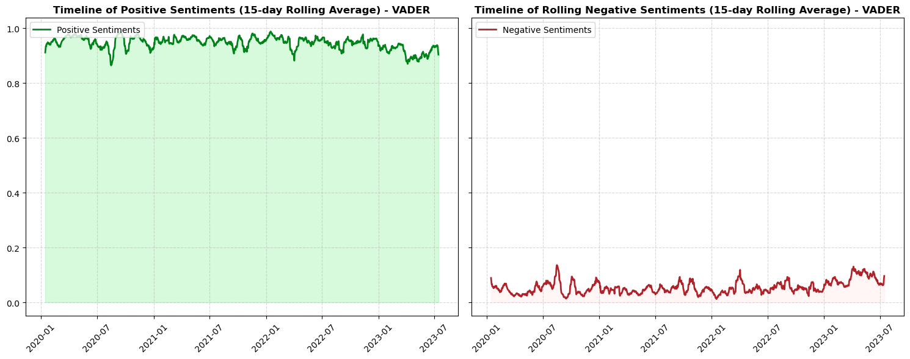
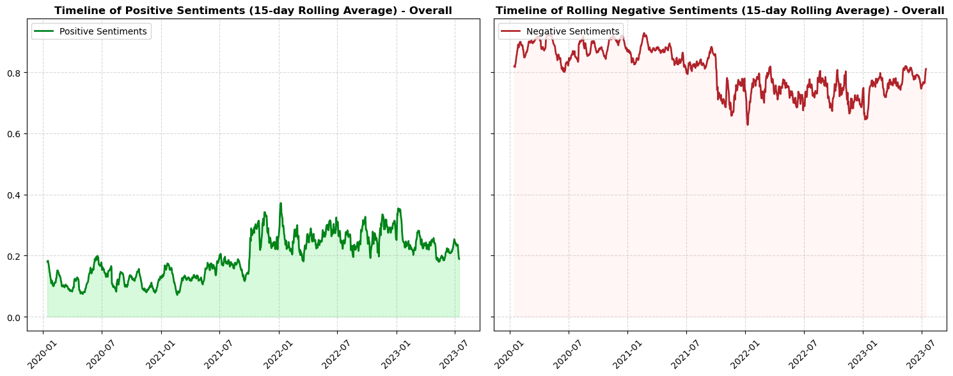
Sentiment Analysis
Integrate VADER & Yelp models to improve sentiment analysis using 15-Day Rolling Average
VADER Sentiment Proportion Analysis
Chart displays rolling averages of sentiment trends providing a clearer view of public opinion on topic.
VADER scored data optimistically positive above 0.8.
Negative sentiment remains below 0.2.
Yelp Sentiment Proportion Analysis
Model: Logistic Regression
Test Accuracy: 95.5% (on Yelp Reviews)
Positive sentiment: Mainly below 0.4
Negative sentiment: Consistently above 0.6
Contradictory sentiment results prompted blended analysis for a more accurate sentiment classification.

Slide 9
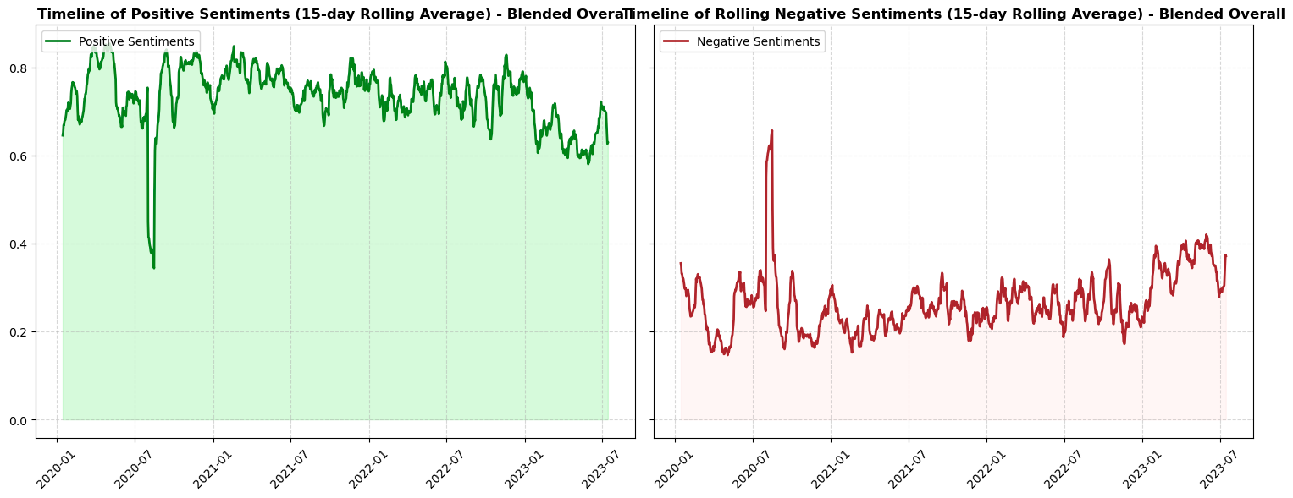
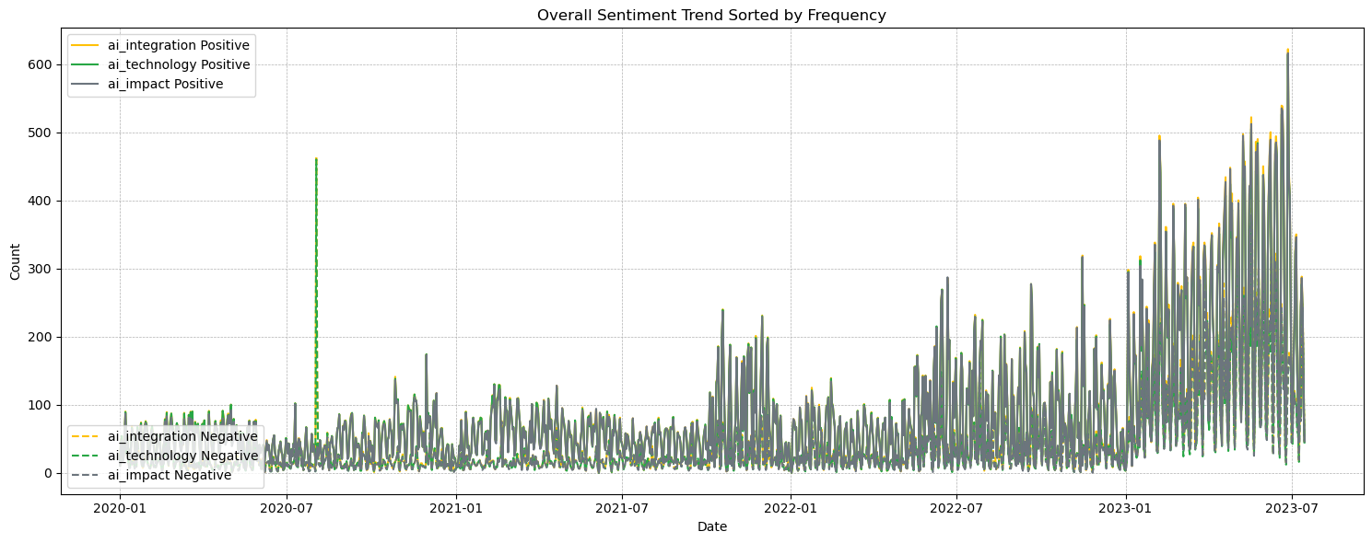
Blended Sentiment Analysis
Leveraging a blended approach with VADER and Yelp enhances sentiment analysis using 15-Day Rolling Avg.
Trust (VADER <= -0.995 & >= 0.995); Otherwise, Trust Yelp
Sentiment Proportion Timeline
Sentiment mostly > 0.6. Post July 2020, public reception notably dipped.
Negative sentiment mostly < 0.4, highlighting the overall positive view of the tech sector.
Sentiment Trend by Frequency
Mentions of ai_integration and tech in July 2020 correlated to lower positivity, suggesting the topic's influence on sentiment.
The surge mentioned indicates rising public interest and engagement.
This trend emphasizes the tech sections' dynamic nature and sets the stage for the next deep dive: sentiment evolution over time.

Slide 10
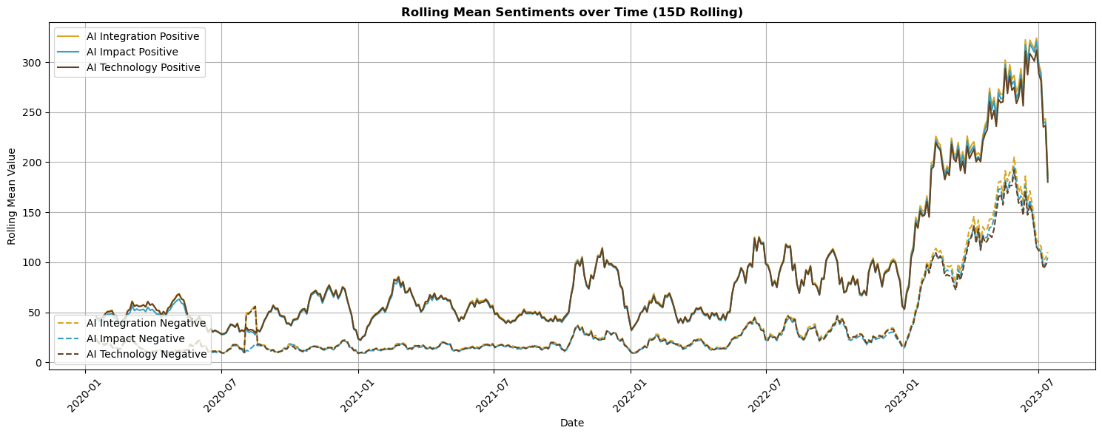
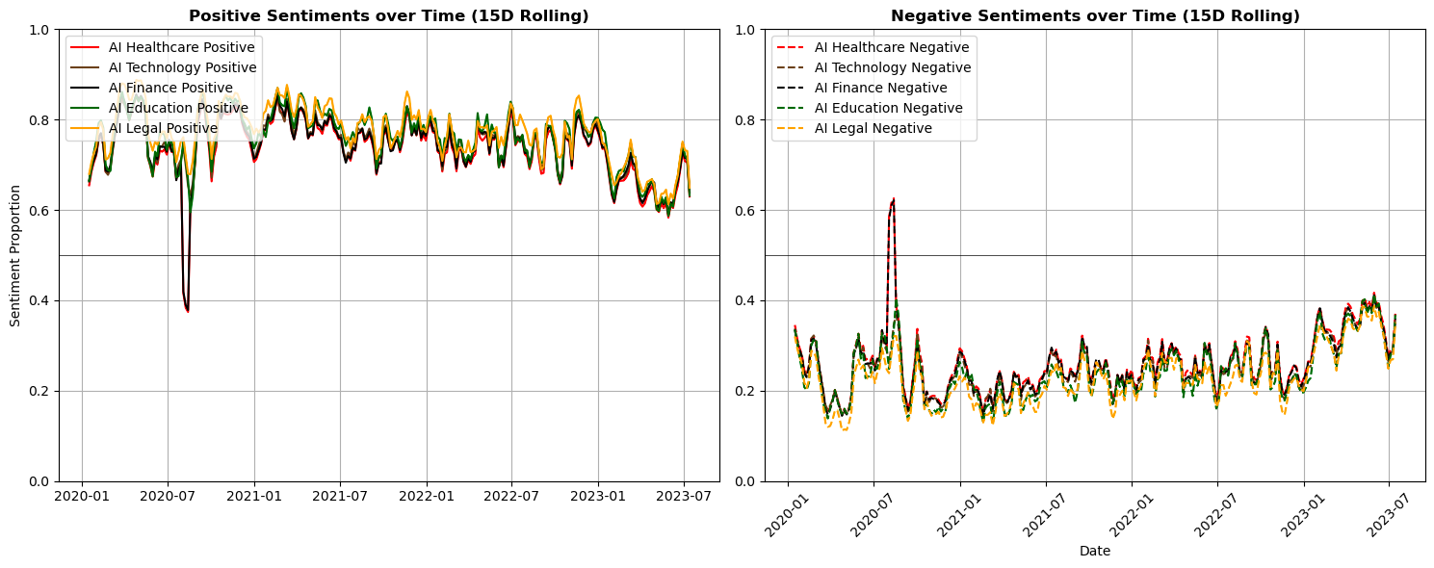
Blended Sentiment over Time Analysis
Utilizing a Combination of Latent Dirichlet Allocation (LDA) & Classification Techniques
15-Day Rolling Mean Trends
Noticeable increase in sentiment post-January 2023.
Positive mentions are twice as frequent as negative mentions.
AI integration dataset shows the most significant surge.
Implies rising confidence in AI's seamless integration and impactful achievements.
Sectoral Sentiment Distribution
Healthcare, tech, and finance sectors saw sentiment drop to 0.4 in July 2020, likely due to criticism of AI.
The subsequent trend shows a gradual decrease in positive sentiment, stabilizing around 0.65 by July 2023.
This indicates a sustained reservation or critical perspective on AI's impact across various sectors, while AI's significant continues to rise.

Slide 11
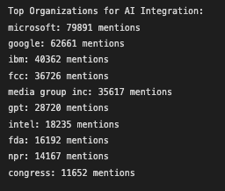
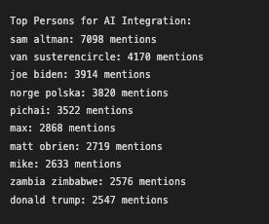
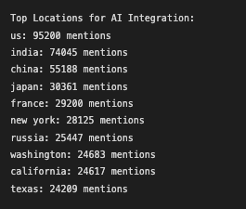
Name Entity Recognition
Top Candidates for AI Integration
Top 10 Organizations
Top 10 Persons
Top 10 Locations
Microsoft tops with ~80k mentions, trailed by Google and IBM.
Sam Altman leads with 7k+ mentions; Joe Biden and Pichai follow.
US dominates with 95k mentions, followed by India and China.

Slide 12
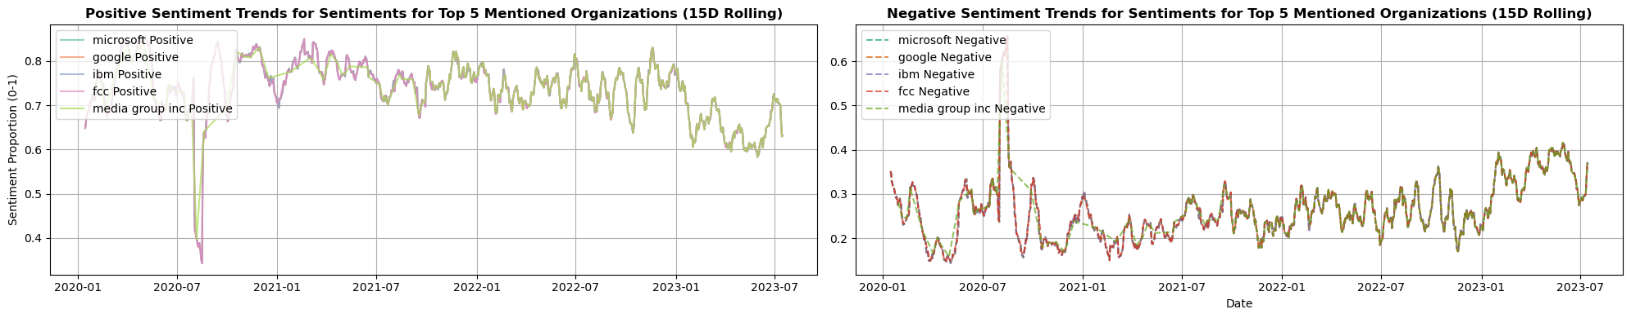
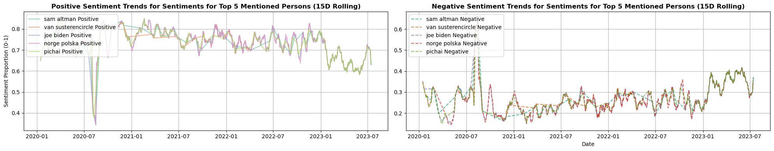
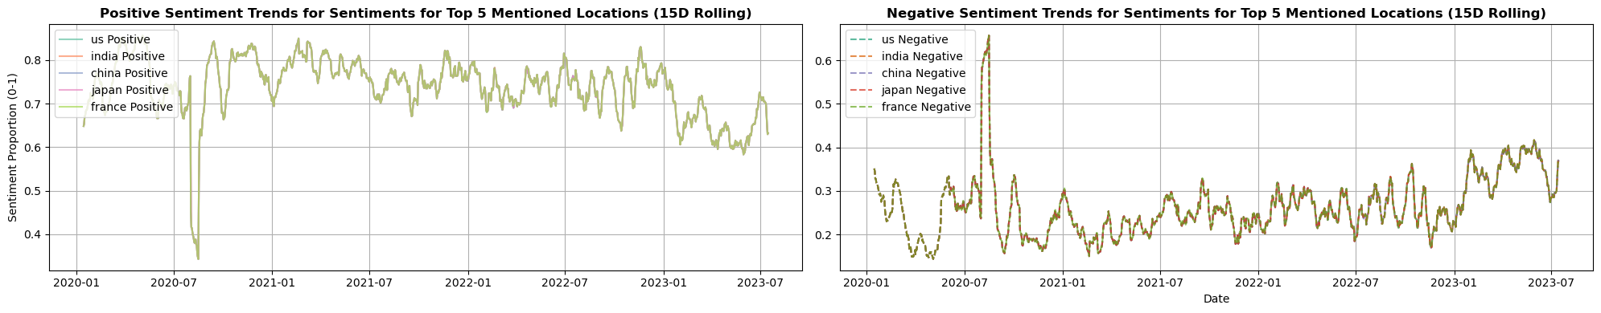
Targeted Sentiment Analysis for Top 5 Candidates
Sentiment Proportion of Top ORG, PER, and LOC/GPE: 1) Media Group & FCC; 2) Altman, Pichai, Polska; 3) US, India

Slide 13
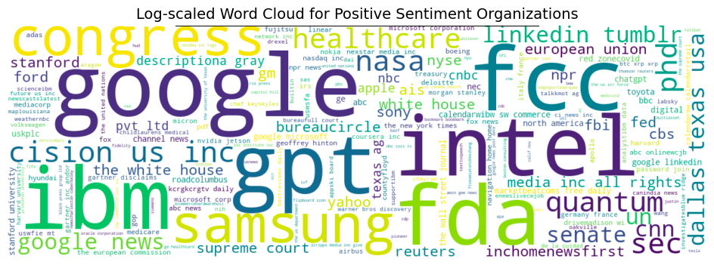
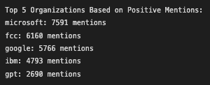
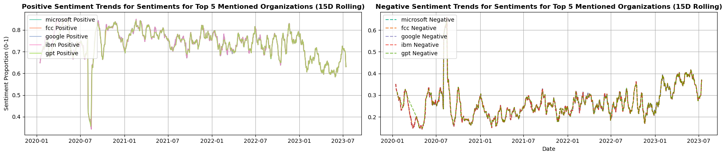
Leading Enterprises in AI Integration
Spearheading AI Investment for Future Innovation
Microsoft, Google, IBM & FCC invest in and regulate AI.
FDA and Samsung recognize AI's potential, showing its far-reaching influence.
Sentiment positive, but declining in 2023; organizations need to reinforce strategies or resolve issues.

Slide 14
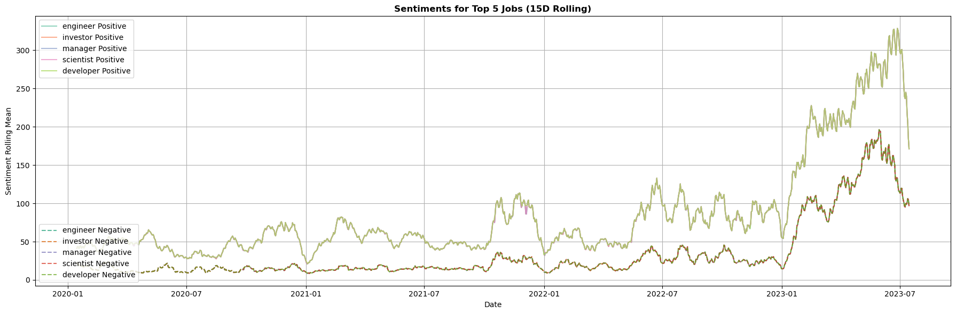
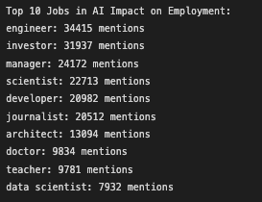
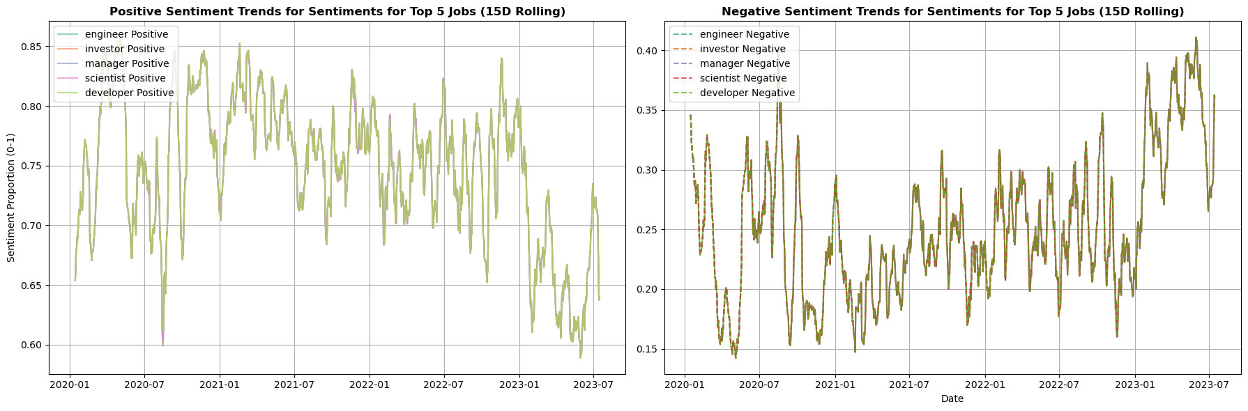
Top Impacted Jobs by AI
Sentiment Analysis Over Time & Proportional Distribution for Top 5 Jobs
Sentiment for top 5 jobs rises after Jan 2023, drops in July 2023.
Sentiment score of 0.65 for top 5 jobs suggests balanced optimism and caution.
Spotting these trends helps anticipate AI job market issues and prospects.

Slide 15
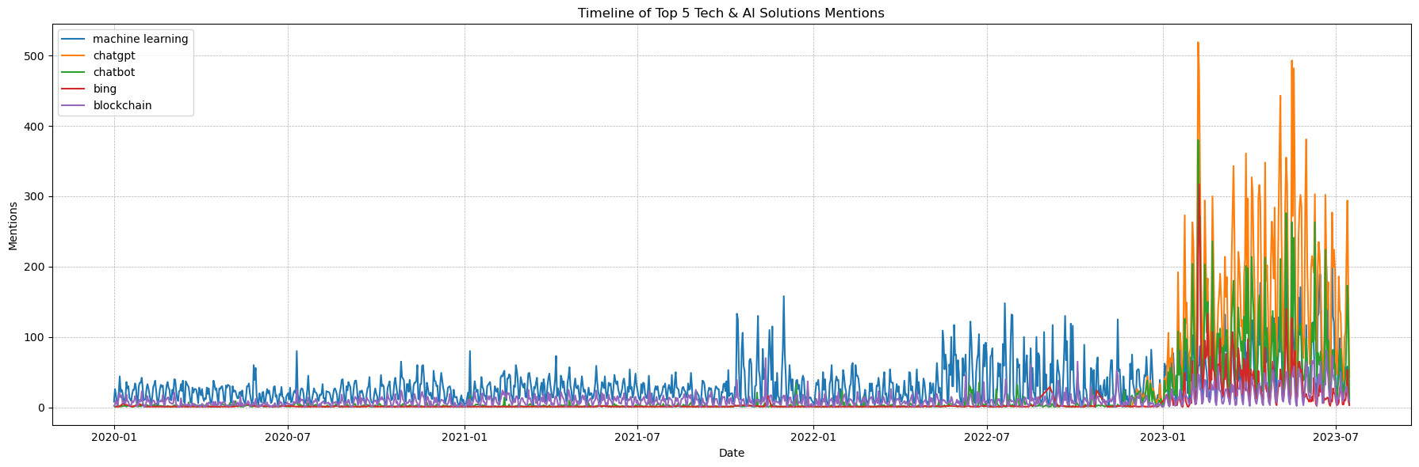
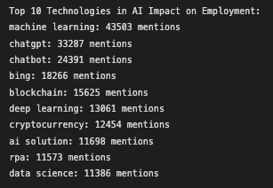
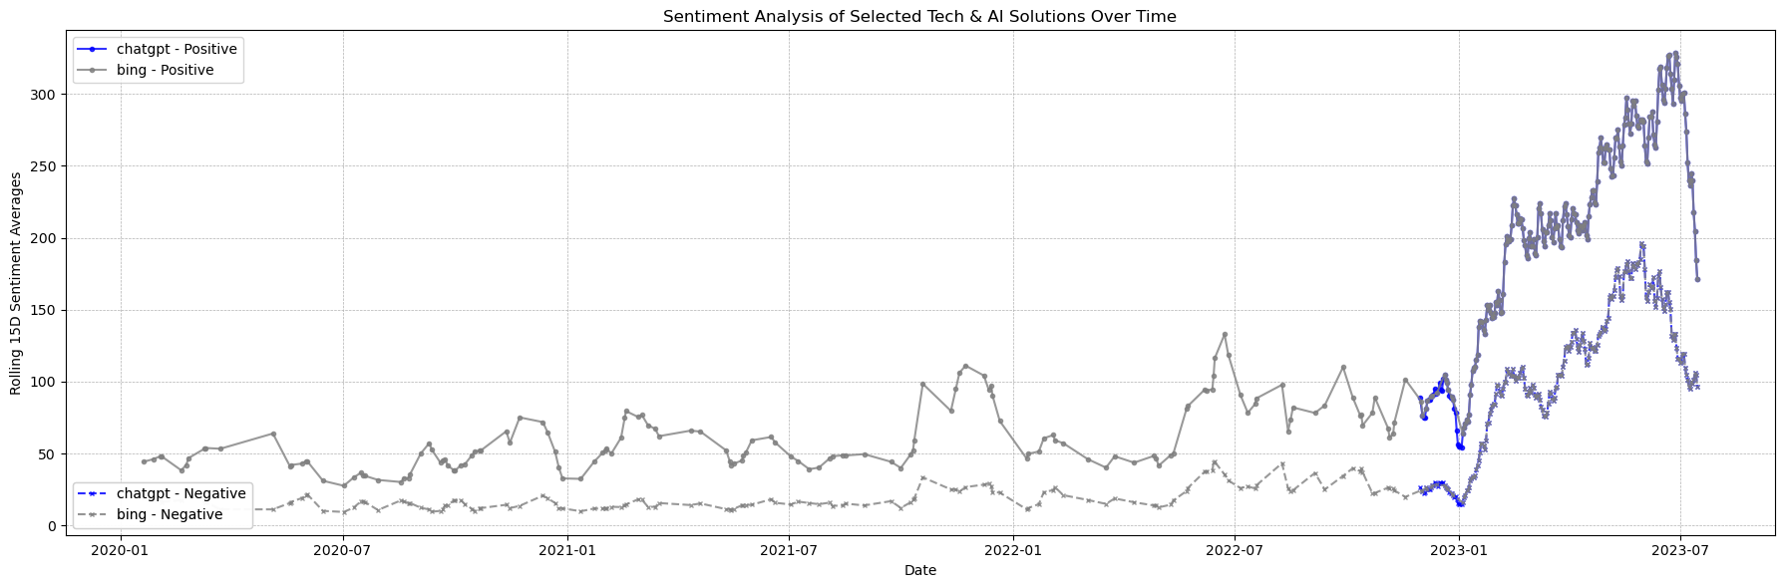
Top New Tech. & AI Solutions
Emerging Technologies Shaping the Future of Employment
ML powers AI, making a lasting impression in multiple sectors.
ChatGPT and Bing are making waves in AI conversation tech, with strong growth projected for 2023.
Blockchain revolutionizing finance, data integrity.

Slide 16
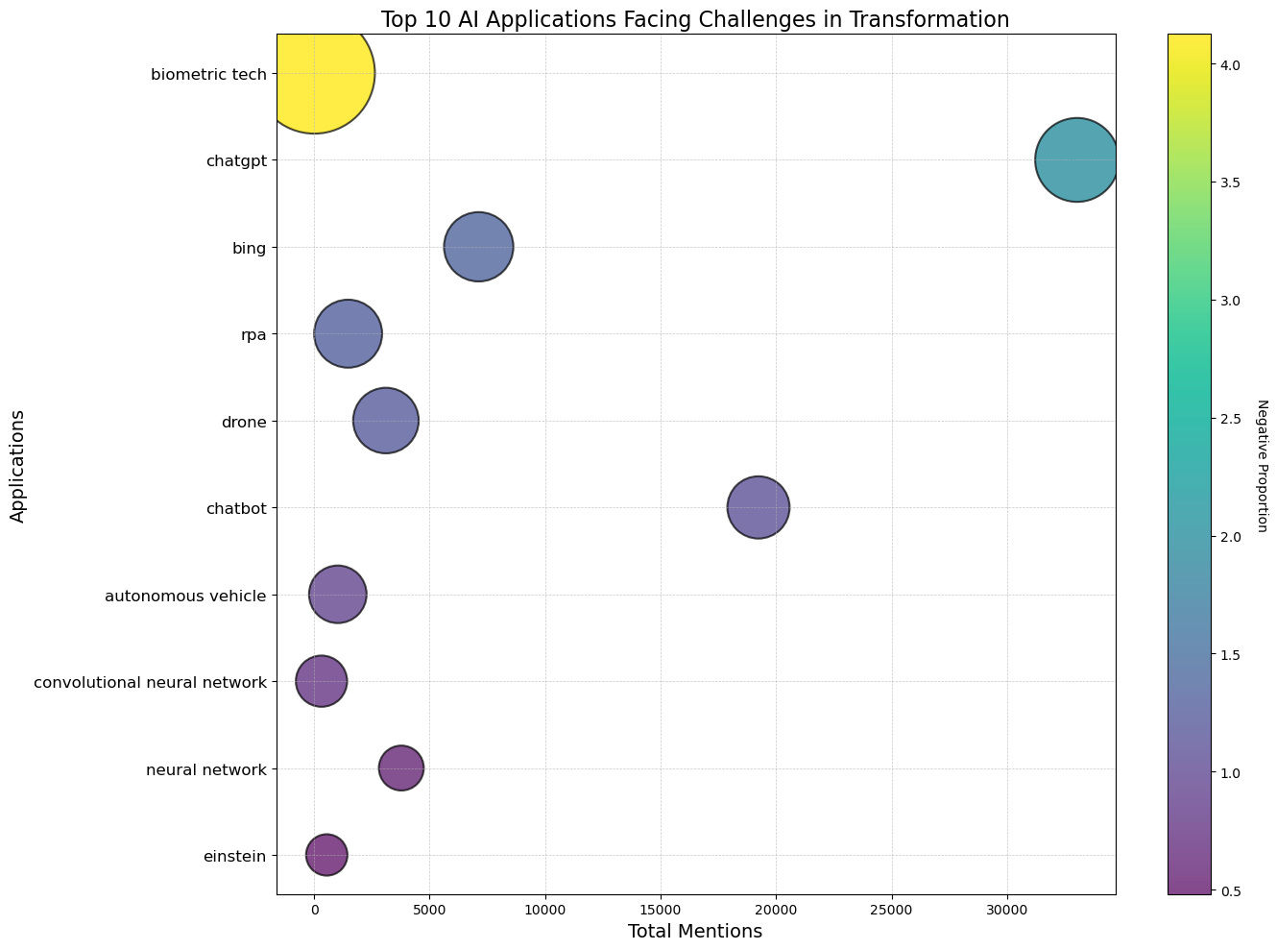
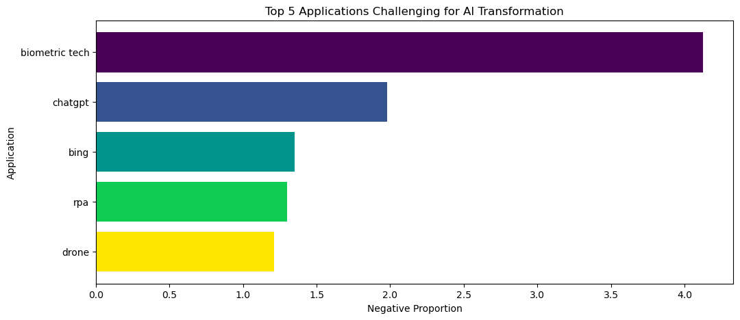
Challenges in AI Application Transformation
Top Applications Indicating Resistance or Limitations in AI Adaptation
Biotech's complexity leads to difficulties due to its intricate biological systems.
AI chatbots may lead to trust and transparency issues, per ChatGPT and Bing.
Op. Hurdles: RPA & drones face deployment & safety issues.
Neural networks call for continual advancement.

Slide 17




Actionable Recommendations
Engage AI Leaders
AI Education
Ethical AI Focus
AI Hub Presence
Collaborate with top AI entities and influencers to strengthen the brand's position.
Offer advanced modules preparing the next generation for AI roles.
Adopt transparent, research-backed methods to ensure ethical AI practices.
Expand visibility in major AI regions with tailored initiatives and hubs.

Slide 18
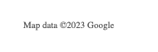
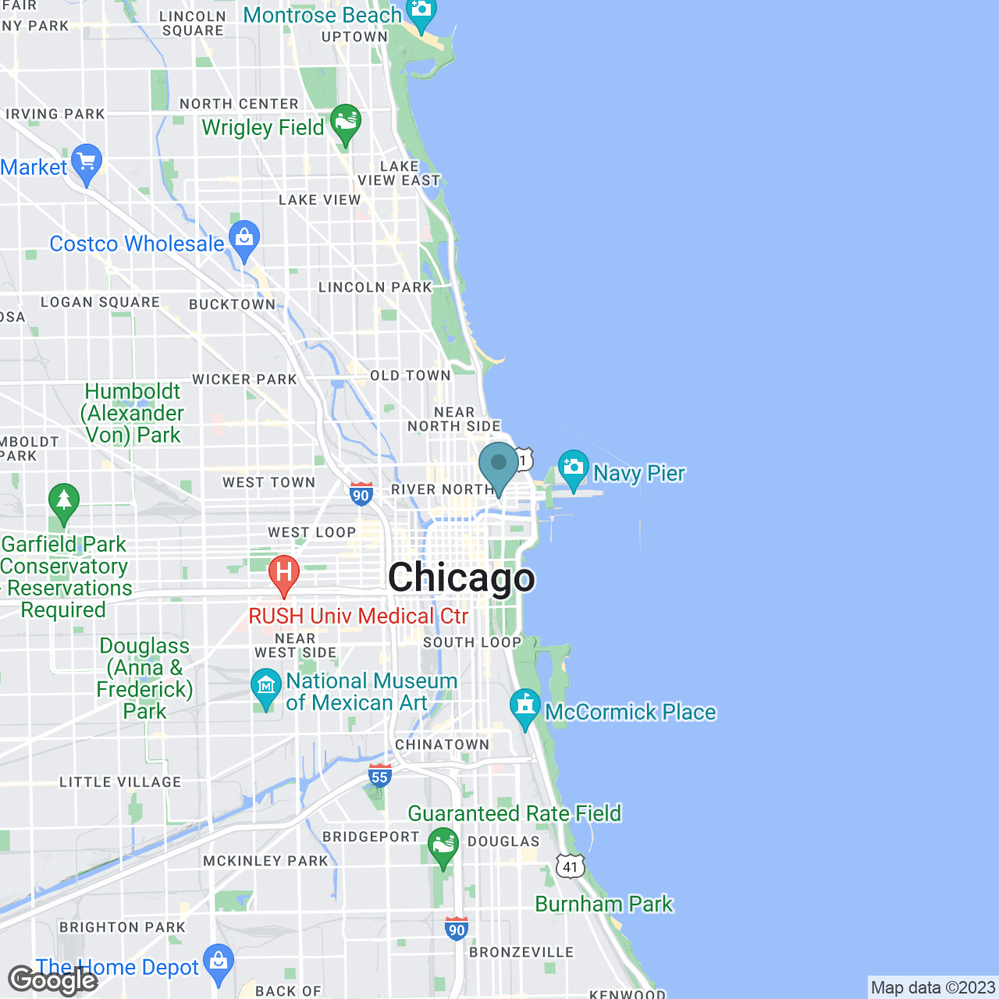



Contact Me
Hyojun Kim
455 Cityfront Plaza Dr, Chicago, IL 60611
kimhyojun@uchicago.edu
LinkedIn: Link
Github: Link

